Slide 1

THE RELATIONSHIP BETWEEN Distribution of LITTER bins and traffic volume in dublin
CS621B SPATIAL DATABASES PROJECT
PENGYU YANG
19253607

Slide 2

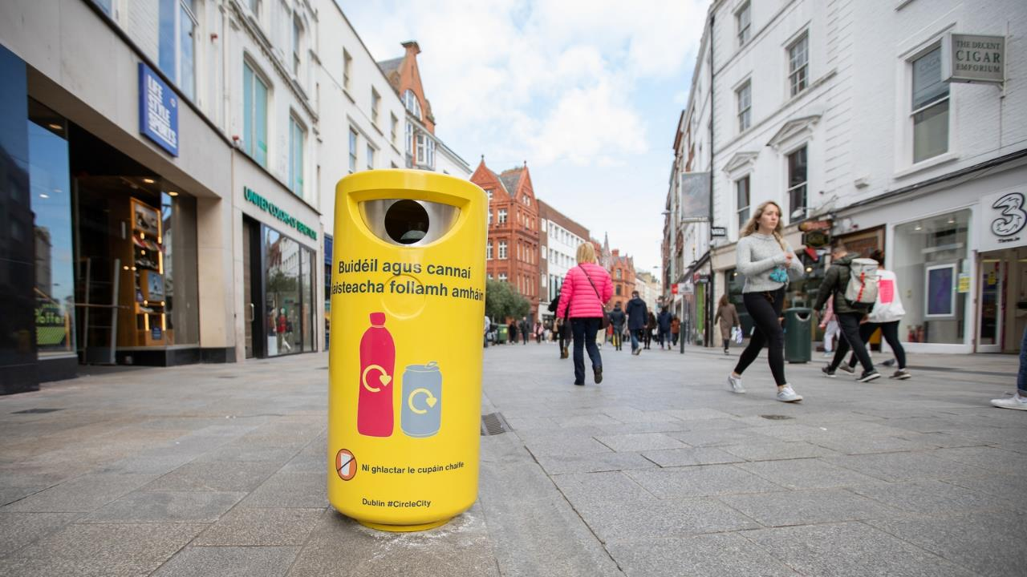
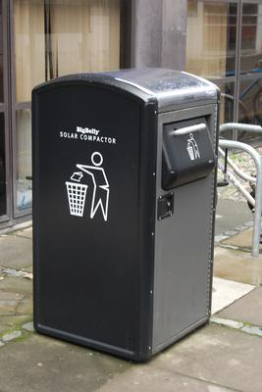
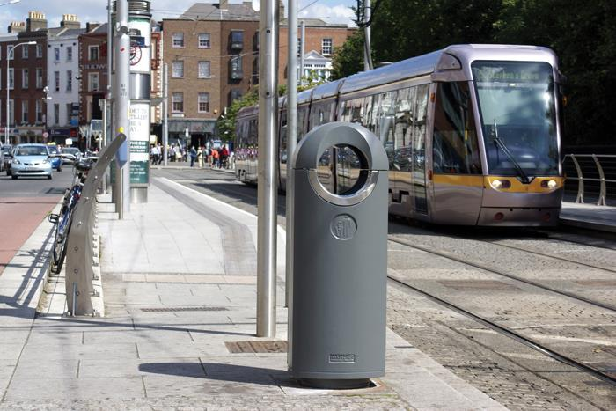
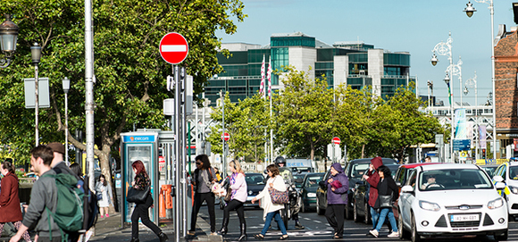

Ordinary but important
Hygiene
Healthier
clean

Slide 3
Data Files
File name | Number of objects | CRS
Dublin postcode(.shp) | 25 objects | EPSG 29902（meter-base)
Dublin public bins (.geojson) | 3172 objects | EPSG 4326
Dublin traffic volume(.csv) ( 01/06/2020) | 823 objects | EPSG4326
Dublin traffic locations(.csv) | 854 objects | EPSG 29902

Slide 4
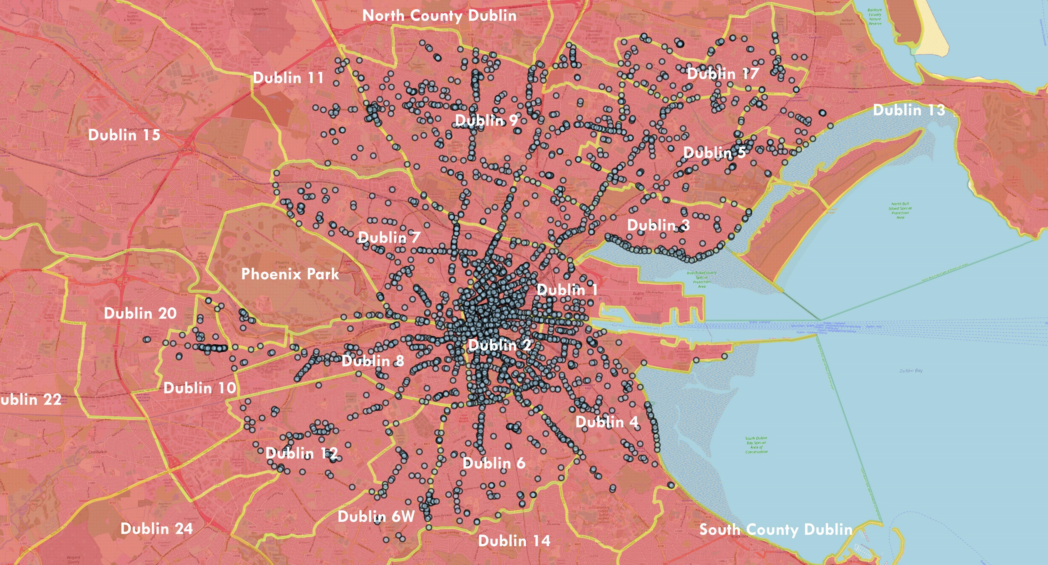
Distribution of bins in Dublin postcode area

Slide 5
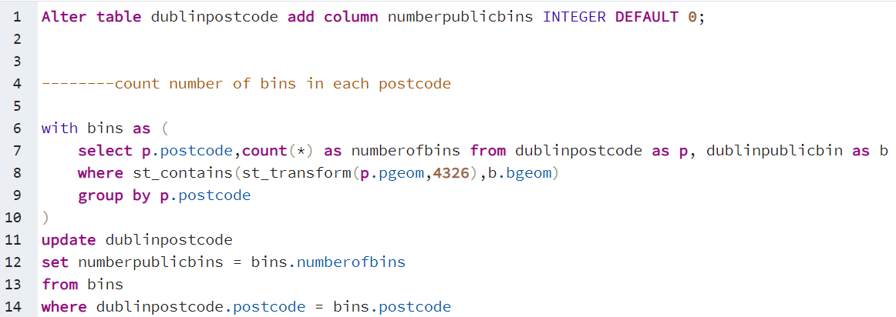
Query 1:

Slide 6
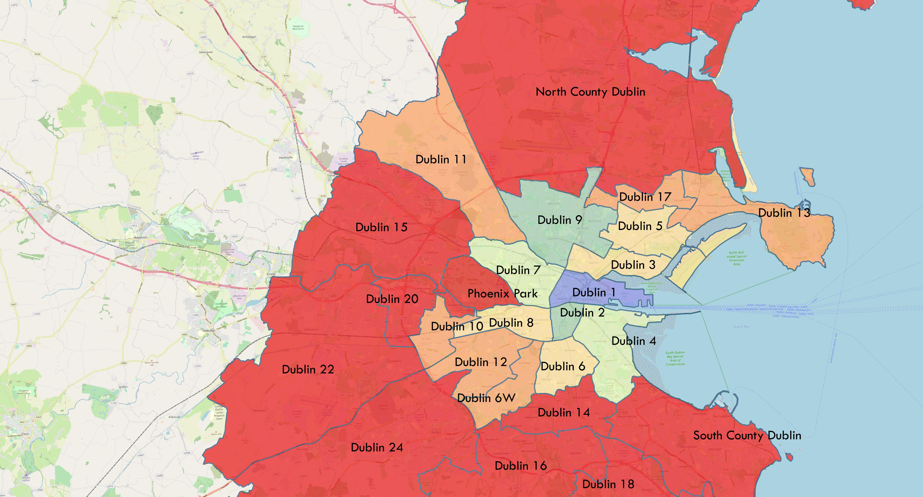
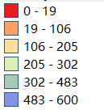
Amount of bins in Dublin postcode area

Slide 7
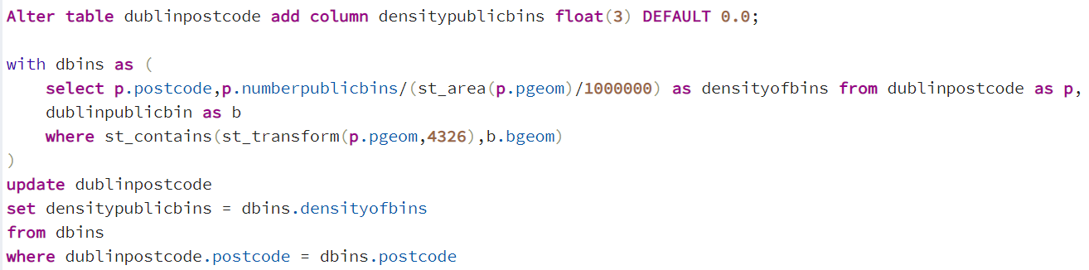
Query 2:

Slide 8
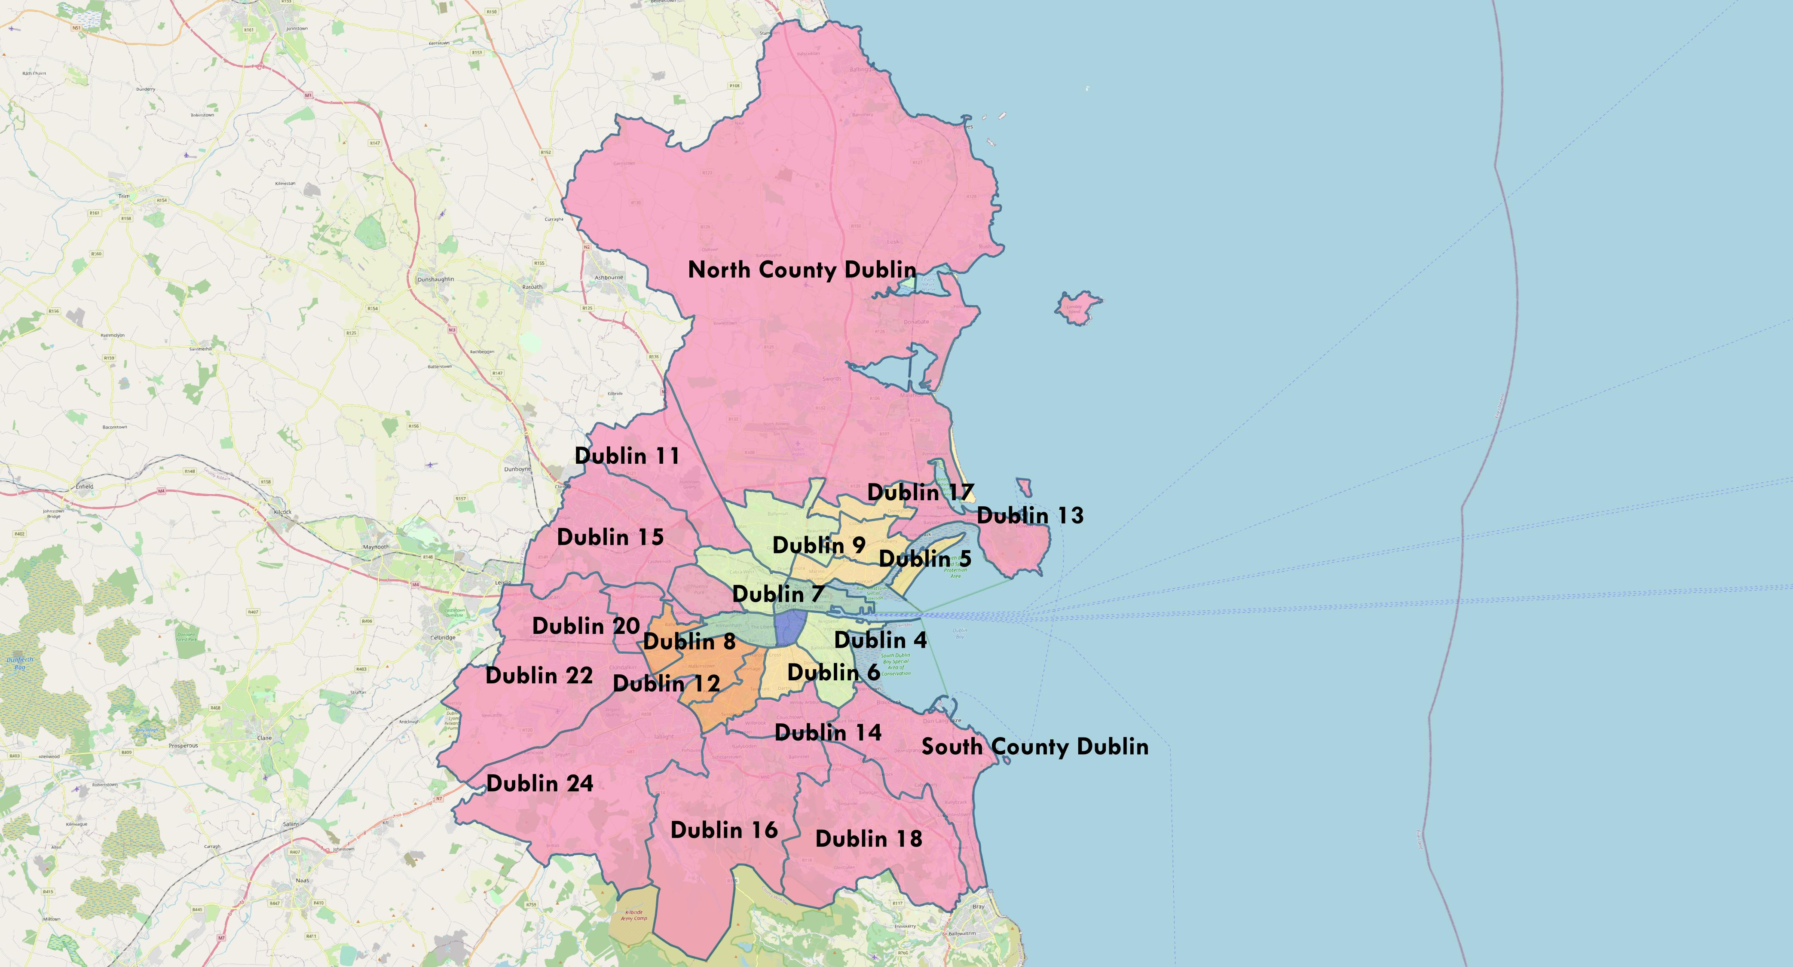
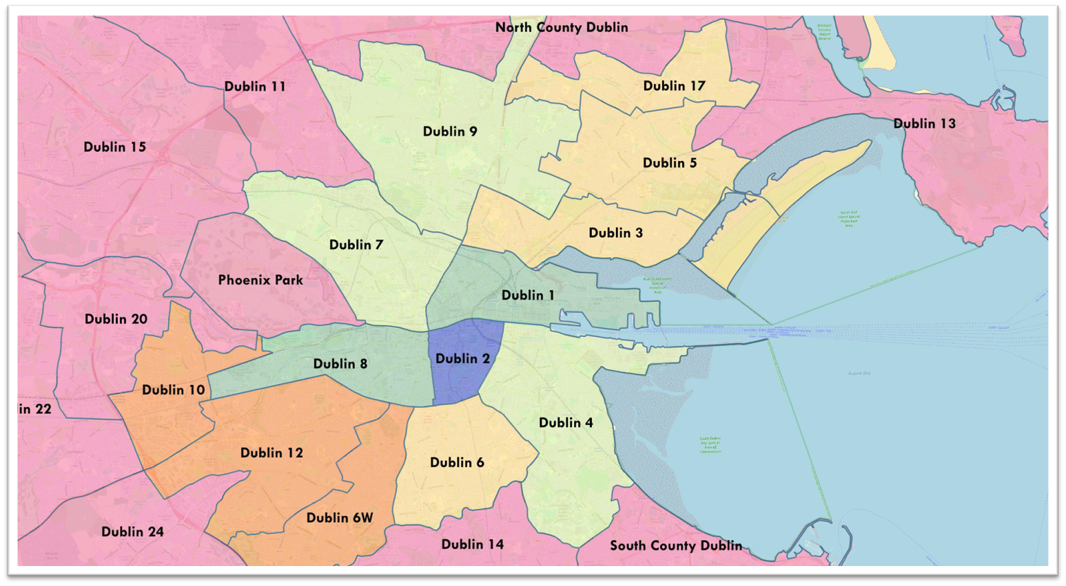
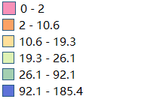
Density of bins in Dublin city area(per km²)

Slide 9
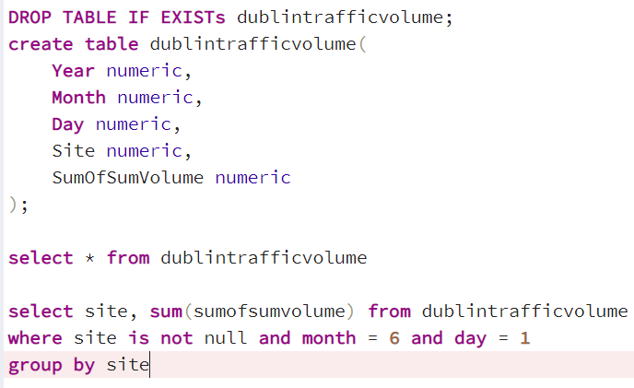
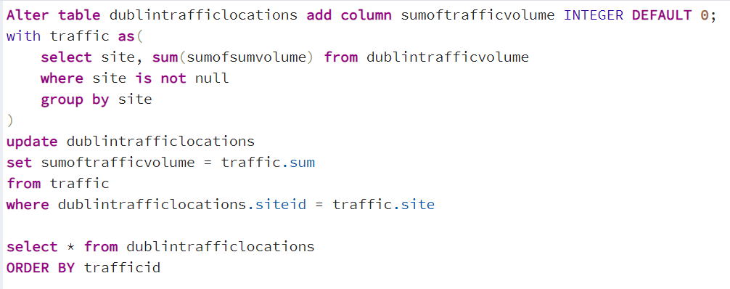
Query 3 :

Slide 10
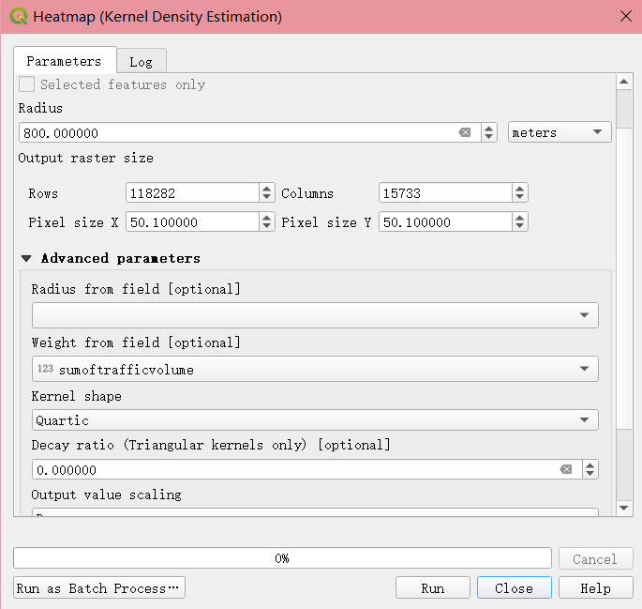
Heatmap set:

Slide 11
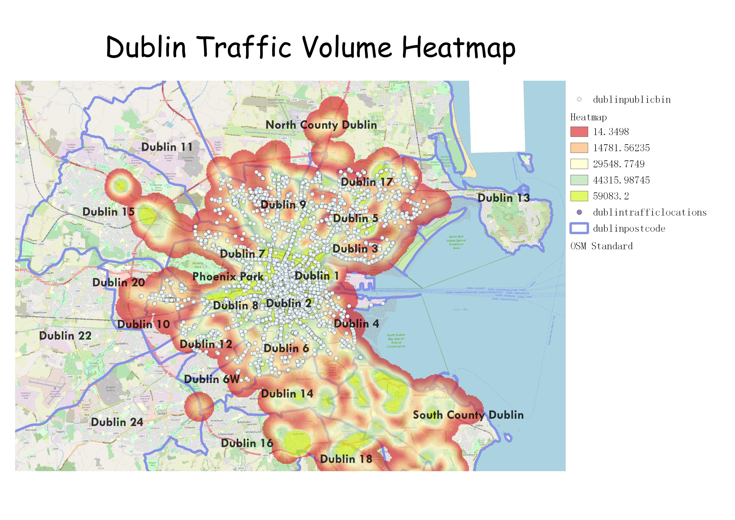
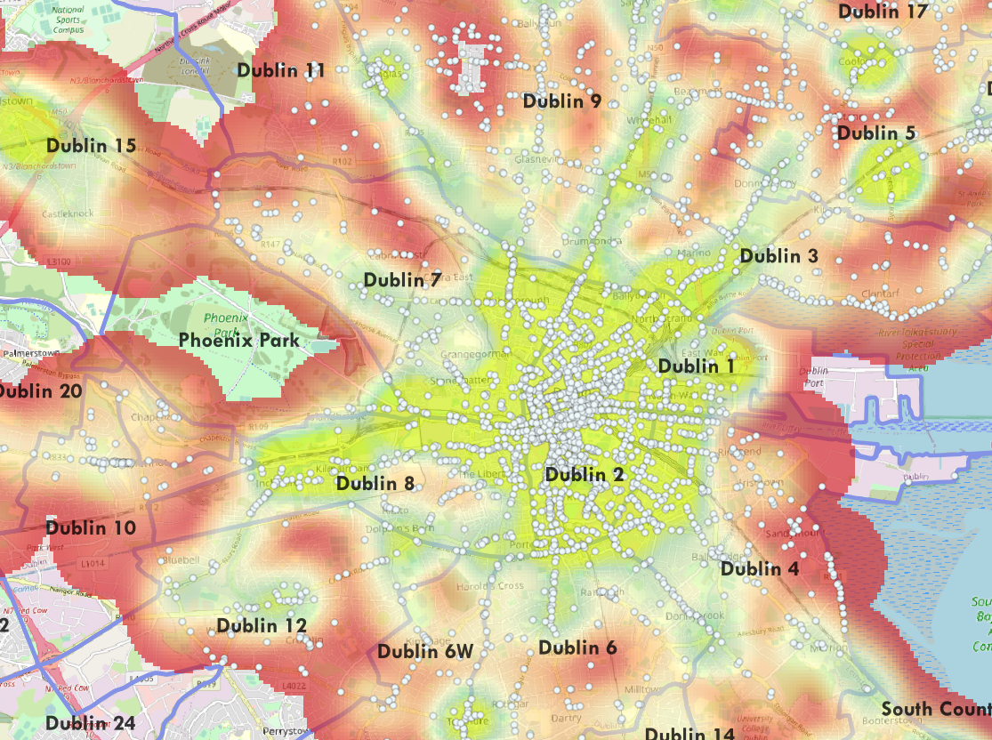

Slide 12
Data SOURCEs
https://data.gov.ie/dataset/dcc-public-bin-locations (Dataset updated: 19/11/2020)
https://github.com/rdmolony/dublin-postcode-shapefiles/tree/master/Postcode_dissolve
3. https://data.smartdublin.ie/dataset/3495362f-06c2-4b06-90f5-3eaa307ab145/resource/653f8222-949c-4a83-b8e0-e4e4b1092b60/download/its_scats_sites_aug-2020.csv (Dataset updated: 02/10/2020)
4. https://data.smartdublin.ie/dataset/3495362f-06c2-4b06-90f5-3eaa307ab145/resource/5f9946a8-f800-4813-9c63-8742df0f15c5/download/scats_detector_volume_jan-jun-2020.csv

Slide 13
Thank you for your time
🍕🍦☕

